Slide 1

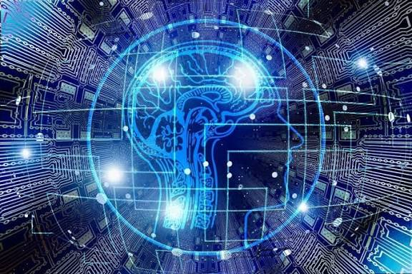
What Is Perception?
Perception is a machines' ability to understand the information it is given.
A machine is not considered intelligent if it is only able to take in information, it is considered intelligent when it can also understand the information it is given.

Slide 2
Why is perception important?
Both humans and machines can collect information, but collecting isn't the same as understanding. When we understand information, we are able to explain it in simpler terms, make adjustments, and make our own judgments based on said information. Without perception, a machine can collect and relay information, but it can't use it intelligently.

Slide 3
Template Matching
A method used to understand images is Template Matching, in essence, the robot stores a templates (bit patterns) for what each digit looks like and compares each section of the camera angle to these templates.
Problems:
Images must be consistent in size.
Handwriting is impossible to understand using this method.

Slide 4
Feature-Based Recognition
Another method is feature based recognition where the AI looks for shapes instead of patterns. It then compares the shapes to known digit descriptions.
Problems:
Small image errors such as C being mistaken for O or 3 being mistaken for B may occur.
This method becomes very inaccurate when details are noisy, distorted, or missing.

Slide 5
Real Images
Template matching and feature based recognition are usually used for easier images such as in the puzzle solving machine we were given in the textbook
Real-life images are much more complicated because objects overlap, appear at different angles and some areas may be hidden or out of the camera range. Real-world images are usually analyzed in two major steps, Image processing and Image analysis.

Slide 6
Image processing
Focuses on extracting visual characterestics and enhancing the image by making boundaries clearer, grouping similar areas, identifying which parts may belong to the same object, removing noise, etc...
Doing this makes the image easier to work with and allows for clearer more accurate data to be collected

Slide 7
Image Analysis
Focuses on understanding what the now processed features mean.
During this step the machine identifies objects then tries to make an educated guess on what that object might mean.
It then checks if the guess matches the features.
Machines still struggle with:
Identifying hidden parts, low lighting,
Perspective changes etc...

Slide 8
Thank You For Listening!!

